Slide 1


Usability & User Experience
Medi Servat
INFO6255 – Software Quality Control & Management
Fall 2019

Slide 2

What is Usability?
Usability is the ease of use and learnability of a human-made object such as a tool or device.
In software engineering, usability is the degree to which a software can be used by specified consumers to achieve the following in a quantified context of use:
Quantified objectives with effectiveness
Efficiency
Satisfaction

Slide 3
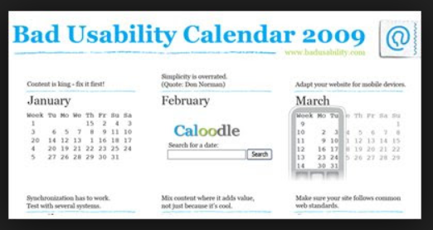
Why is Usability Important?
People will leave a web site for the following reasons:
It is difficult to use.
The home page does not specify clearly what the company offers.
The users get lost in it.
No clear direction or agenda.
The web site does not answer the users’ questions.
No logical tier structure.

Slide 4

What is User Experience (UX)?
User Experience = Look + Feel + Usability

Slide 5
What is User Experience (UX)?
User experience refers to a person's emotions and attitudes about using a particular product, system or service.
It includes the practical, experiential, affective, meaningful and valuable aspects of human–computer interaction and product ownership.

Slide 6

User Experience
The following are what meaningful and valuable user experience, information must be:
Useful: The Web content should be original and fulfill a need.
Usable: The site must be easy to use.
Desirable: Image, identity, brand, and other design elements are used to evoke emotion and appreciation.
Findable: Content needs to be navigable and locatable onsite and offsite.
Accessible: Content needs to be accessible to people with disabilities.
Credible: Users must trust and believe what you tell them.
https://www.usability.gov/what-and-why/user-experience.html

Slide 7

What is ‘User Experience Testing’?
User experience testing is the process of collecting qualitative and quantitative data from the user, whilst the user is subject to all aspects of a service or product
Evaluating a User Interface
The two main techniques for evaluating a user interface are
Empirical Evaluation (testing with users)
Heuristic Evaluation (based on a set of rules)

Slide 8
Why Usability Testing is Needed?
Usability testing is greatly needed for evaluating a website's functionality and making sure people can navigate it efficiently.
A web site’s bad design will not bring a lot of users to it. So, it is important to have the user feel good about it.

Slide 9

Usability Testing Methods
Moderated vs Unmoderated Usability Testing
Remote Usability tests are done remotely for increasing the number of users
In Person Usability tests are done in presence of UX/Moderator. More expensive.
Moderated – In person offer most control and collects more in-depth information.
Explorative – Open Ended, Brainstorming.
Assessment Research is used to test user’s satisfaction, General functionality
Comparative – Asking users to choose which solution they prefer.
https://www.hotjar.com/usability-testing/methods

Slide 10
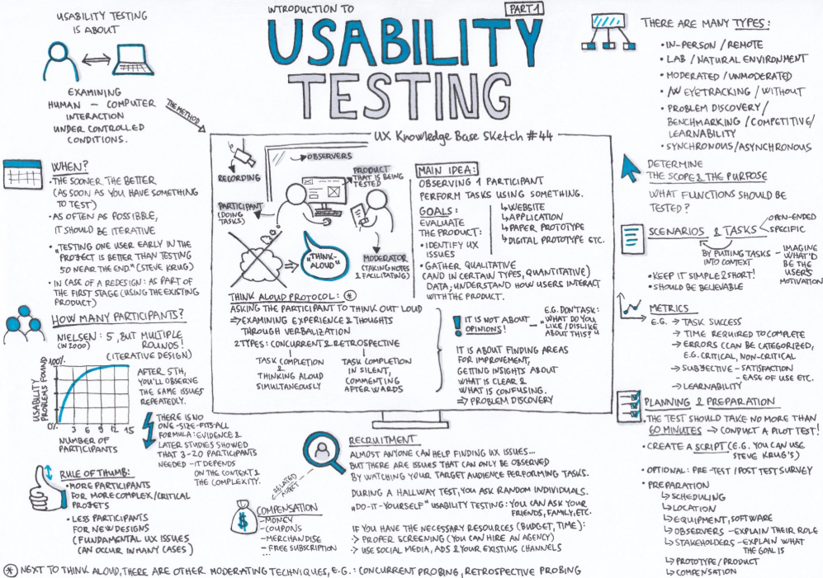
Usability Testing Methods
Guerrilla testing - test subjects are chosen at random from a public places for a quick usability testing
Remote – Moderated - On the phone. Economical way to collect information
Remote – Unmoderated – relying on computer programs. Session recording to track the movement of the users and collect information.
In-Person – Unmoderated
https://www.hotjar.com/usability-testing/methods

Slide 11
Moderated Usability Testing
Plan
Plan the testing session
Get
Get Participants
Design
Design the tasks
Run
Run the session
Analyze
Analyze the results

Slide 12
Best Tools For Evaluating User Experience
For Research to better understand what the user is clicking on and what catches their attention:
UserTesting
UsabilityTools
ClickTale
Usabilla
Verify
For Designing an intuitive and flexible User Interface:
InVision
Balsamiq
Pidoco
MockFlow
Proto.io
A/B Testing
Optimizely
https://www.dtelepathy.com/blog/business/14-best-tools-for-evaluating-user-experience

Slide 13
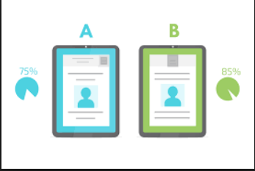
What is A/B Testing?
A/B testing (also known as split testing or bucket testing) is a method of comparing two versions of a webpage or app against each other to determine which one performs better.

Slide 14

A/B Testing Process
Collect Data: In the high traffic area of the web site.
Identify Goals: Goals can be anything such as clicking links.
Generate Hypothesis: What is the impact and the difficulty.
Create Variations: Customize your choices to the elements of the web site
Run Experiment: Allow the users to come into the Web Site
Analyze Results: Analyze the data for the differences
https://www.optimizely.com/optimization-glossary/ab-testing/

Slide 15
References
https://www.hotjar.com/usability-testing/methods
https://www.dtelepathy.com/blog/business/14-best-tools-for-evaluating-user-experience
https://www.optimizely.com/optimization-glossary/ab-testing/

